Slide 1
THE INDIGENOUS STORY TELLER (IST): The Northern Cape as a case study
Prof Karen Harris CR Botha Tiffaney Morolong
Department of Historical and Heritage Studies University of Pretoria (2018-2019)
Research Seminar 15 March 2019

Slide 2
Research Report of 2017-2018
A POLICY REVIEW OF THE TOURIST GUIDING SECTOR IN SOUTH AFRICA
Department of Heritage and historical studies
University of Pretoria
2017 – 2018

Slide 3
A POLICY REVIEW OF THE TOURIST
GUIDING SECTOR IN SOUTH AFRICA
p. 204
extend the tourism domain so as to be more inclusive of community members
local voice, with inherent knowledge, could enhance the authenticity of the tourist experience
contribute to the transformation of the sector
encompass the inclusion of indigenous knowledge in the very broadest sense
add to the uniqueness and genuineness of the tourist’s experience

Slide 4
p. 205.
not been fully explored academically or in practice
consider a “soft” skilling competency programme for ISTs
develop a strategy for the inclusion of the IST within the tourist guiding domain and a mechanism to monitor this within the established three-tiered hierarchy of tourist guides
develop a procedure to incorporate these community voices into the tourist experience

Slide 5
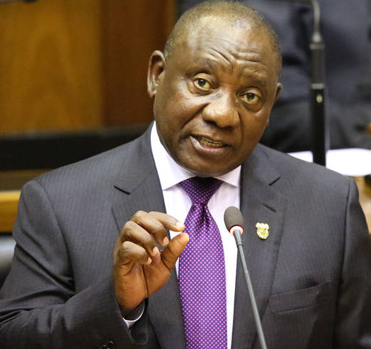
President Cyril Ramaphosa:
SONA 2018: “tourism provides our country with incredible opportunities to, quite literally, SHINE“…“there is no reason why it can’t double in size”
SONA 2019: “We are focusing our attention, our policies and our programmes on the key parts of the economy that are labour intensive. These include agriculture, tourism and the ocean economy
State of the Nation Address
(February 2018 and 2019)

Slide 6
SINCE 1990 NATURE OF TOURISM CHANGED:
Elitist & service-based
Experienced-based
Conventional and general
Novel & authentic
Need for renewal
Indigenous
communities

Slide 7
“STORY”
DESTINATION or PEOPLE
VALUABLE & UNIQUE
EXPERIENCE
STORY-SCAPES
EXPERIENCE ECONOMY

Slide 8
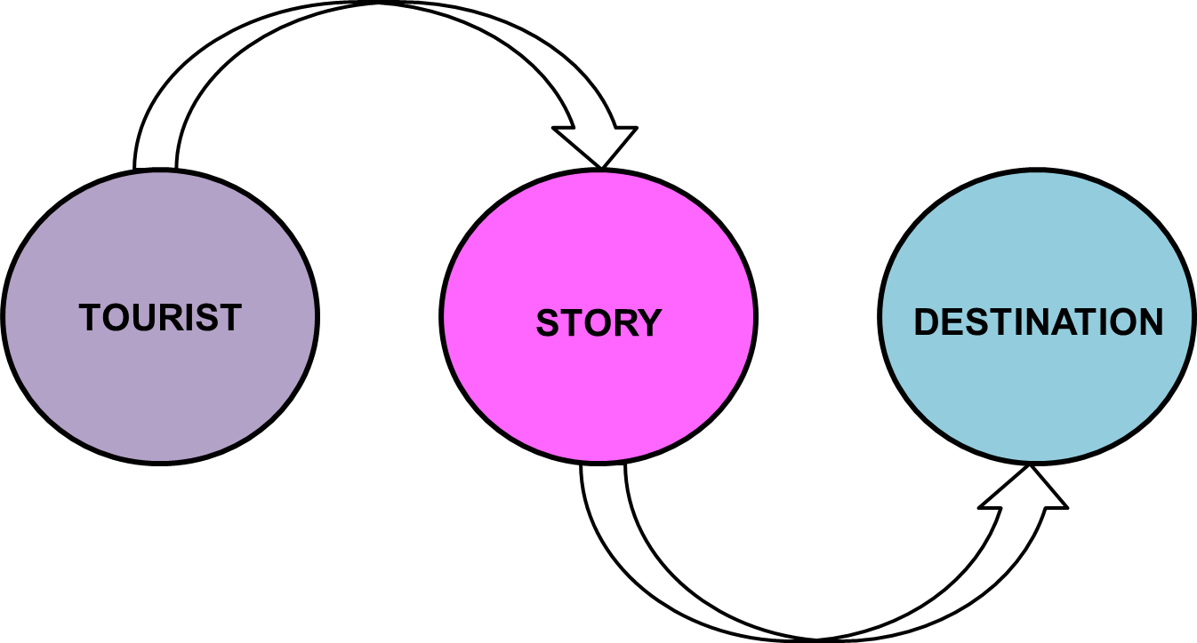
STORYTELLING
- People are by nature story tellers
- Storytelling predates writing,
inherent to all
- Story conduit between the tourist
and destination

Slide 9
INDIGENOUS
PEOPLE
part of the fabric of the site
interpret the value within their
own cultural context
- adds another dimension beyond
what is observed to experience
what is heard and imagined

Slide 10
Components in creating ISTs

Slide 11
Three phases of “Storification”
Phase 1 – Story Identify
core, base, permanent
(internal factors)
Phase 2 – Story Stage
process, telling, image
Phase 3 – Service story script
creation, influence, audience
(external factors)

Slide 12
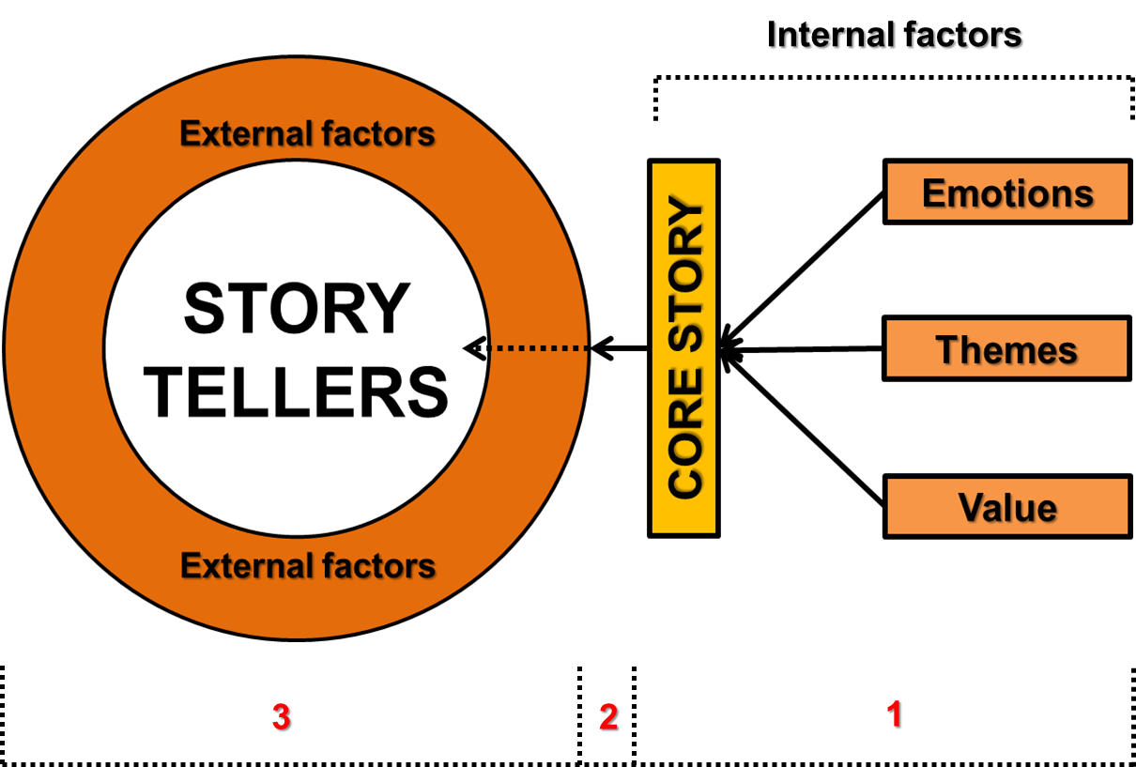
“Storification” process

Slide 13
International Storytelling Center
- “ART FORM”
- “art of using languages,
vocalization and/or
physical movement or
gesture to reveal images
of a story … to an audience”
- “all people are story tellers”

Slide 14
Literature Review
Indigenous communities
Storytelling
Tourist guiding

Slide 15
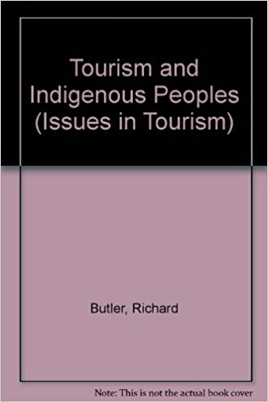
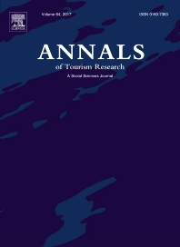
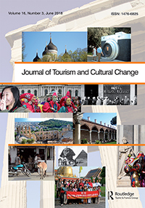
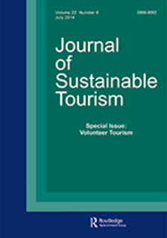
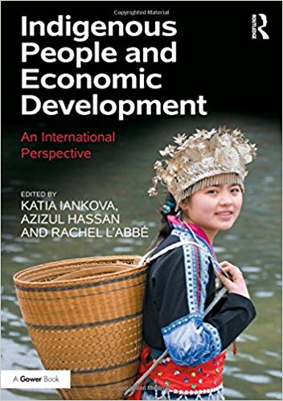
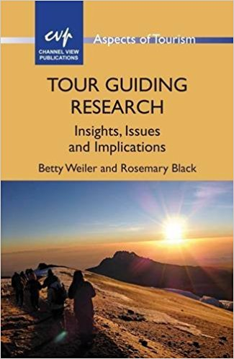

Slide 16
Literature Review
“Indigenous storytelling”
Global North:
Australia: Aboriginal people
New Zealand: Maori
USA: Native Americans
Canada: Native Canadians
Africa:
African storytelling
Cradle of storytelling

Slide 17
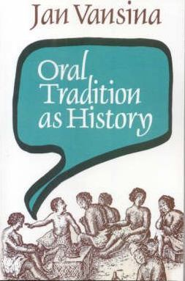
ORAL TRADITION
“…living Museum of the whole stock of social
cultural output stored up by the peoples who
are purported to have no written records”
“…oral tradition …puts flesh on the bones of the past…”
“…individuals who originate in a particular setting; belong to an identifiable group; are able to tell and relate stories being told in a specific context…”

Slide 18
Tourism & Indigenous communities
Positives:
Economic up-liftment
Employment
Poverty reduction
Negatives:
Authenticity?
Commoditization
Disruptions

Slide 19
Touristic
Experience
Modes
Recreational - entertainment
Diversionary - escape
Experiential - meaning
Experimental - alternatives
Existential - spiritual

Slide 20
ROLES OF THE
TOURIST GUIDE
Organiser
Actor
Interpreter/Translator
Salesperson
Buffer
Information-Giver
Teacher
Shaman
Catalyst
Ambassador
Mediator
Caretaker
Middleman
Intermediary
Culture Broker
Leader

Slide 21
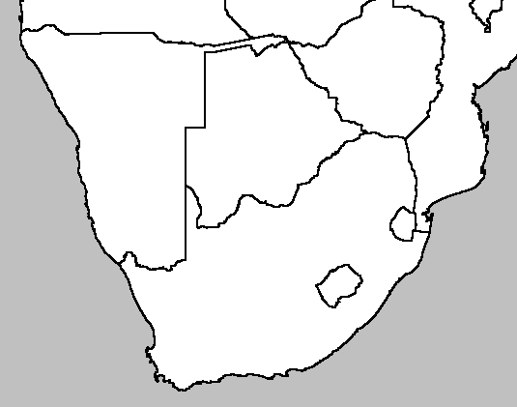
Tourist Guide Classification
Cross-border TG
National TG
Provincial TG
Local / Site TG
Specialist TG
?

Slide 22
Three tier tourist guiding hierarchy
National
Provincial
Local
Site

Slide 23
CULTURE TOURIST
GUIDE
TOURISTS
IST

Slide 24
Positioning ISTs in tourist guiding hierarchy
National
Provincial
IST
Local
Site

Slide 25
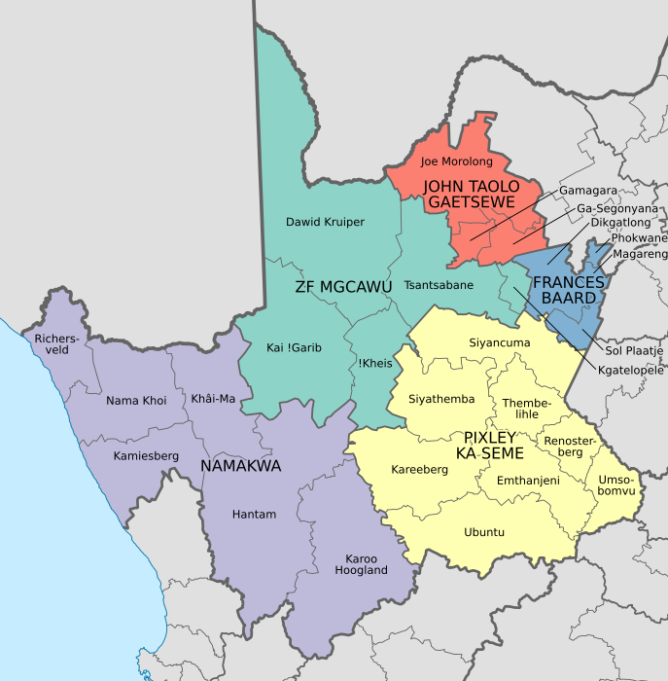
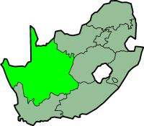
NORTHERN CAPE

Slide 26
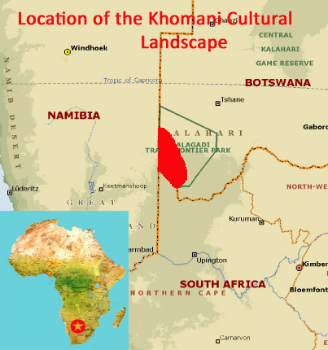
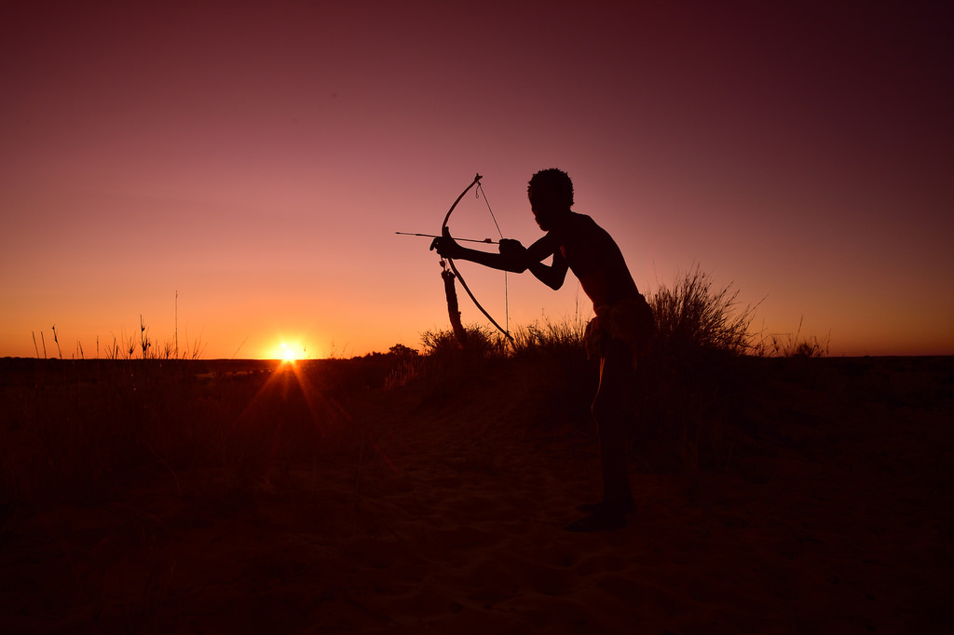
NORTHERN CAPE
KHOMANI SAN

Slide 27
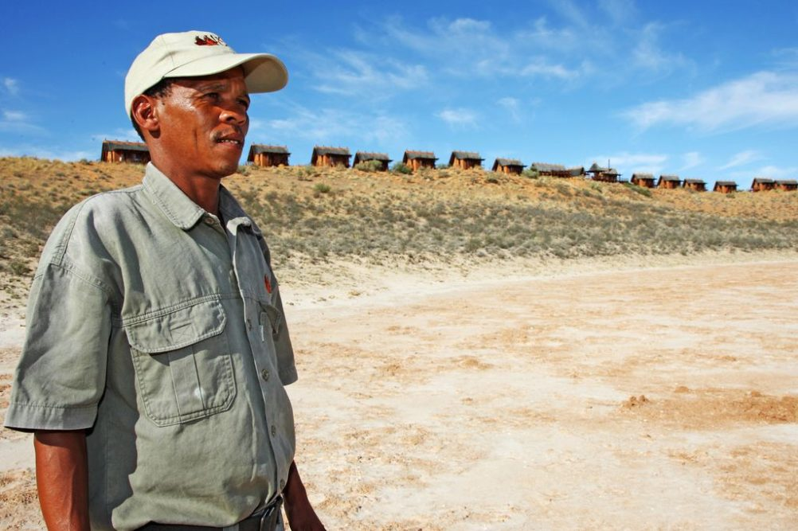
Khomani
San

Slide 28
IST
individual who originates in a
particular setting
belong to an identifiable group
tell and relate stories being told in a specific context
Adds another dimension

Slide 29
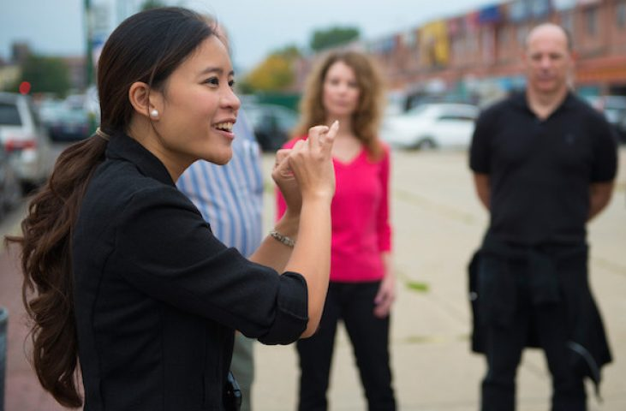
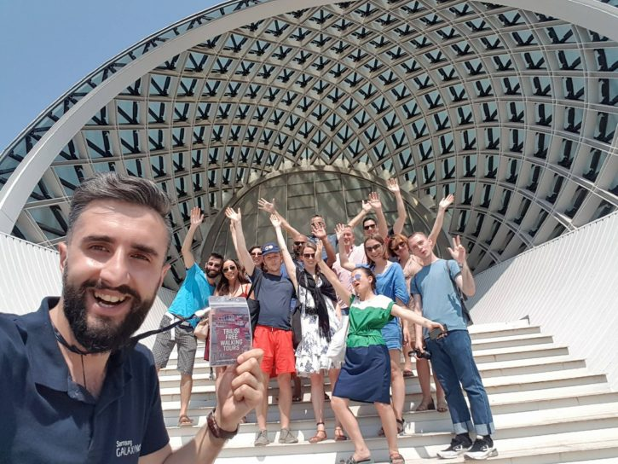
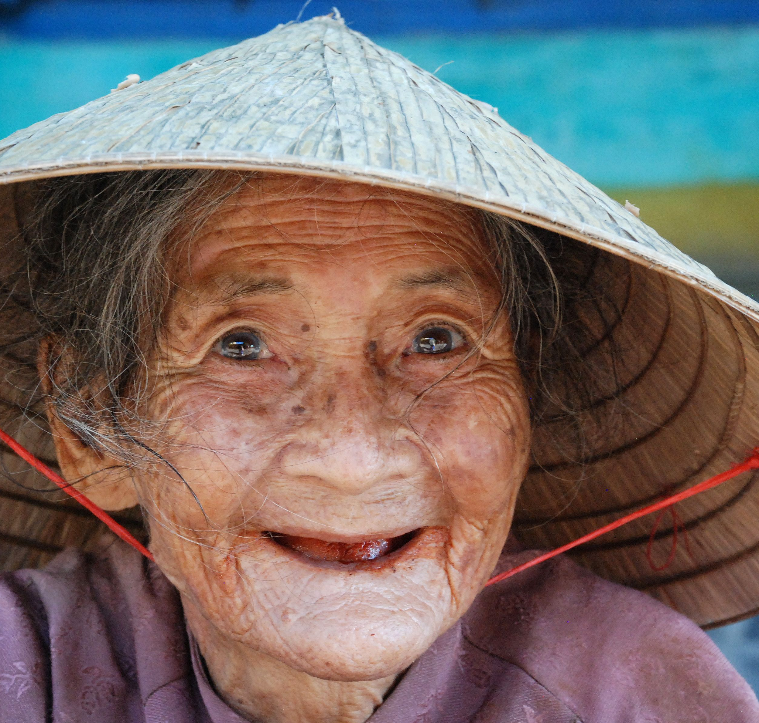
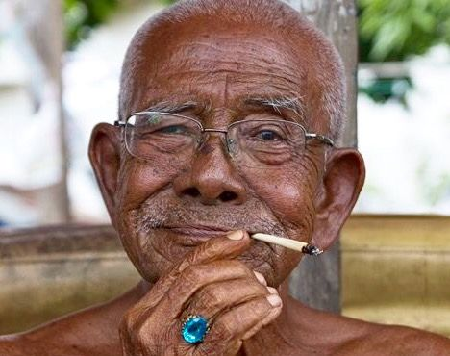
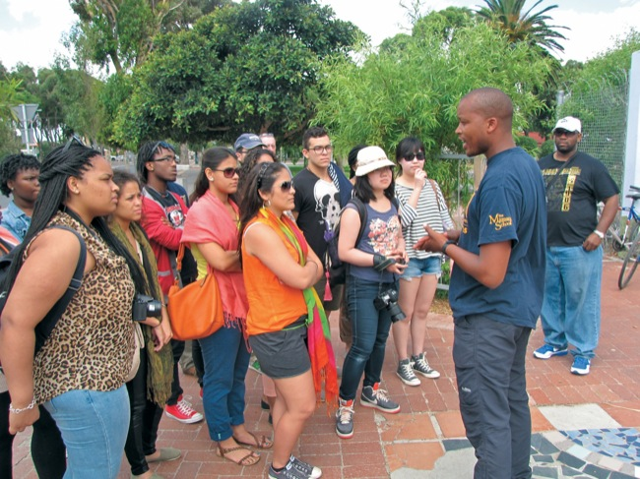
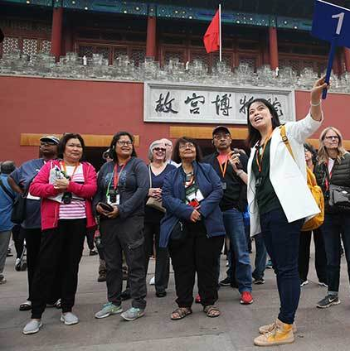
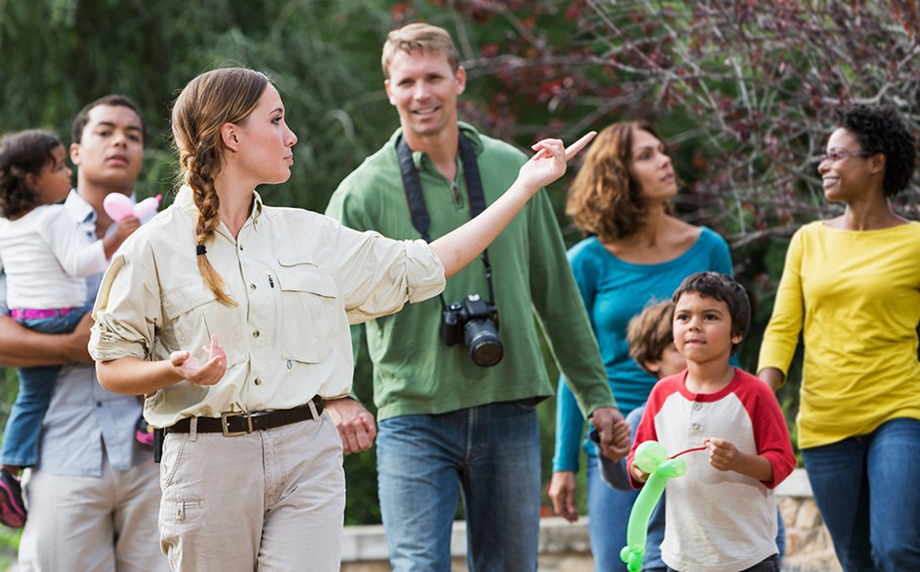
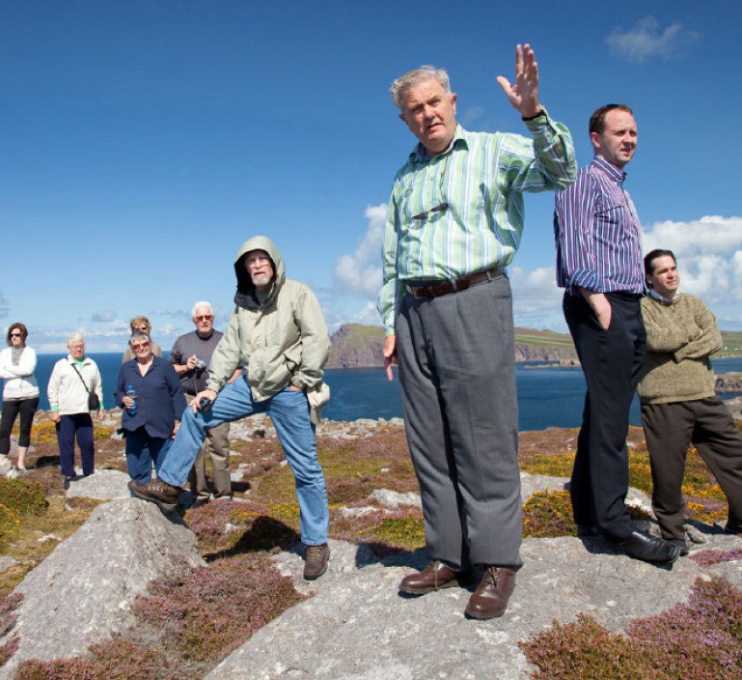
EXPERIENCE
TOURIST GUIDE

Slide 30
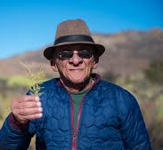
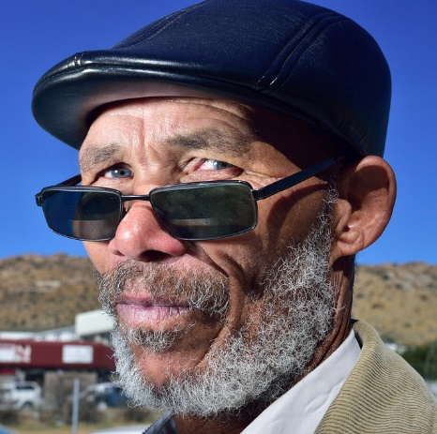
NORTHERN CAPE PROVINCE

Slide 32
Draft regulations for Tourist Guides:
If an individual operates as a tourist guide
but has not met the specific requirements
with regards to training, accreditation and
registration as a tourist guide then they are
officially in contravention of the Tourism Act
3 of 2014.
Tourism Act 3 of 2014: PREAMBLE
And since transformation is vital to ensure
the sustainable growth and development of
the tourism sector.
And since …environment that is conducive
to the sustainable growth, development and
transformation of tourism

Slide 33
B. Weiler
& D. Davis
Roles and responsibilities uniquely compiled for a
“HERITAGE GUIDE” - our Culture Guide
When dealing with isolated communities (ISTs) more
emphasis on tourist guide’s abilities to adhere to
heritage and cultural identities
Need to set the principle tourists need to follow in
terms of authenticity, cultural sensitivity and
behavioural attributes
Unlike Adventure and Nature guide, the Heritage
guide needs to balance between:
General tourism
Experience
Resource management
And adopt a collective approach to including the
tourist, the environment and the community in the
overall tourist narrative .
B. Weiler & D. Davis. ‘An exploratory investigation into the roles of the nature-based tour leader’, Tourism Management 14 (2), 1993, pp. 91-98.

Slide 34
CULTURE GUIDE RESPONSIBILITIES
SPHERE 1
TOURISM MANAGEMENT
Organiser
Entertainer
Focus
on tourists
SPHERE 2
EXPERIENCE MANAGEMENT
Group leader
Teacher
Focus on the tourist interacting with the IST
SPHERE 3
RESOURCE MANAGEMENT
Motivator leader
Interpreter
Focus on IST’s environment

Slide 35
CULTURE TOURIST GUIDE:
Compulsory:
ID 335802 | Conduct a tourist guided cultural experience, NQF Level 4, 12 credits.
Additional Unit Standards:
ID 119869: | Demonstrate knowledge of Iron Age archaeology, Level 4, 10 Credits.
ID 119870: | Research a Southern African archaeological site from published and unpublished material, Level 4, 6 Credits.
ID 119877: | Demonstrate knowledge of Stone Age archaeology, Level 4, 10 Credits.
ID 262305: | Plan and implement minimum environmental impact practices, Level 4, 5 Credits.
ID 335803: | Research and plan a guided experience at a prominent tourism site, Level 4, 5 Credits
ID 262317: | Lead participants through an outdoor recreation and adventure activity, Level 4, 10 Credits.
ID 262320: | Manage and organise groups, Level 4, 10 Credits.
Eight culture tourist guide unit standards
CULTURE GUIDE

Slide 36
Additional culture guide unit standard – IST
CULTURE TOURIST GUIDE:
Additional Unit Standards:
New Unit Standard | Facilitate the IST, Level 4, 10 Credits.
CULTURE GUIDE
- facilitate the inclusion of the IST in the tourism offering
- made aware of the sensitive and possible sacred nature of the encounter with the IST
- conservator in ensuring that the IST’s landscape is preserved and not damaged
- mediate between the IST and the tourist group as an intercultural communicator
- comply and execute the payment of the IST according to predetermined fees
- cultural tourist guide becomes a co-creator of the IST experience.

Slide 37
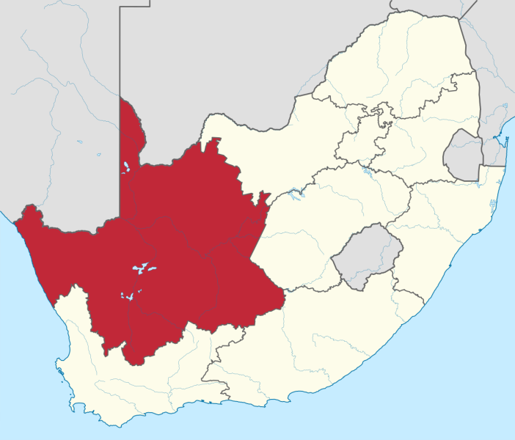
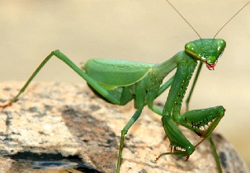
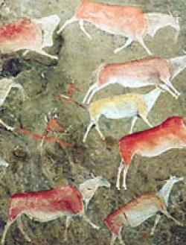
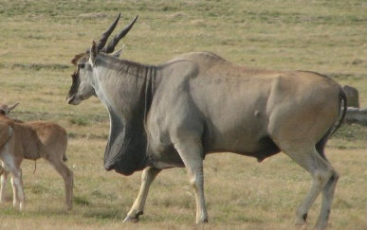
THE INDIGENOUS STORY TELLER:
THE NORTHERN CAPE
Cross-border TG
National TG
Provincial TG
Local / Site TG
Specialist TG
IST

Slide 38
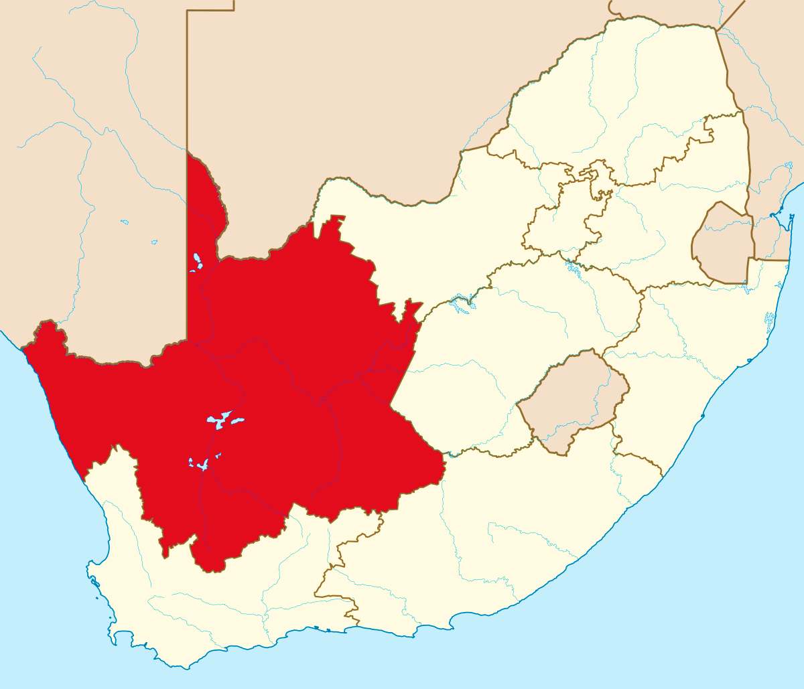
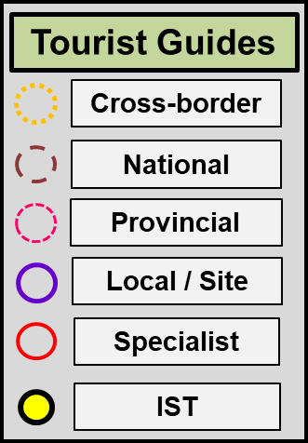
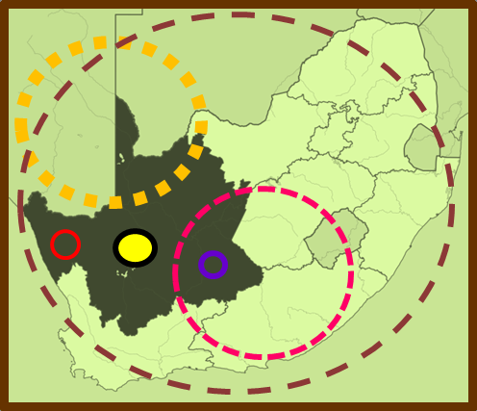
THE INDIGENOUS STORY TELLER (IST):
THE NORTHERN CAPE AS A CASE STUDY
- an individual who originates in a particular setting; belongs to an identifiable group; tells and relates stories being told in a specific context, while adding another dimension to the experience.
Culture guide
KLH, C.R. Botha, T. Morolong

Slide 39
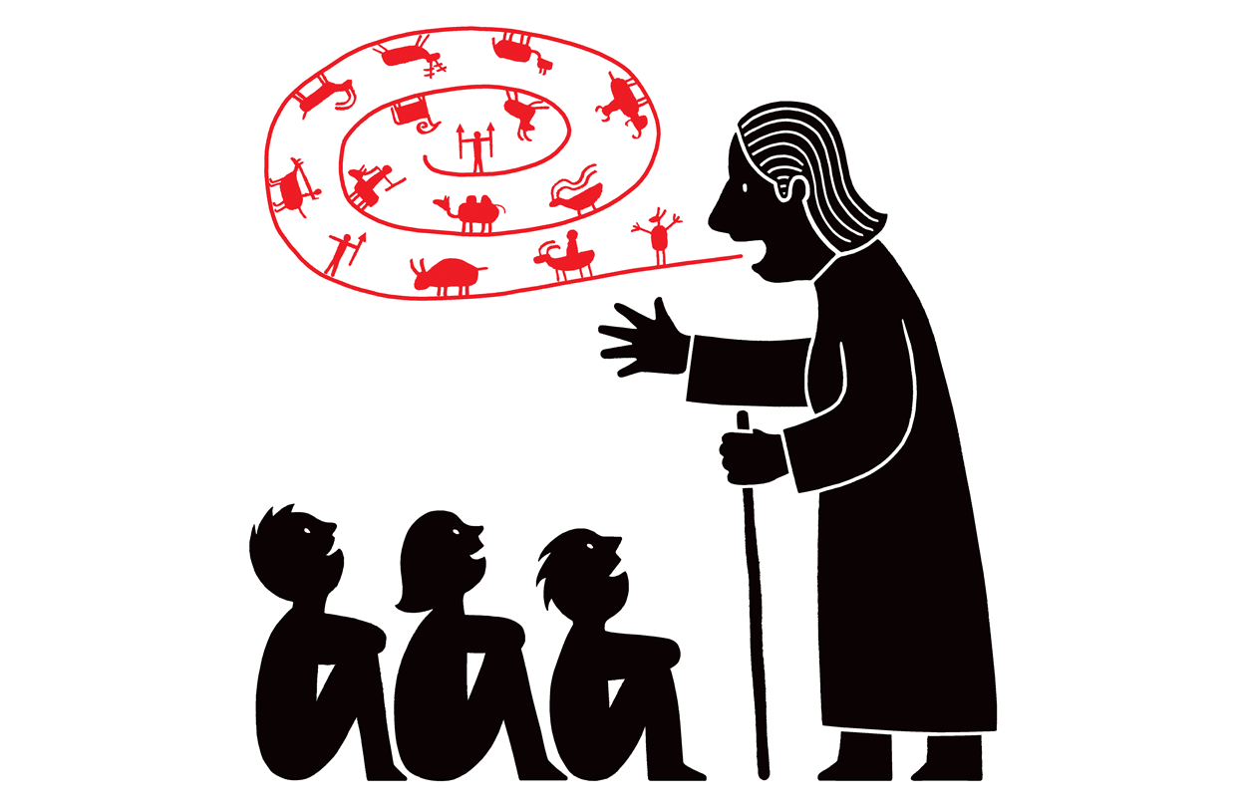

Slide 40
Thank you!
Professor Karen Harris
Mr CR Botha
Ms Tiffaney Morolong

